Slide 1
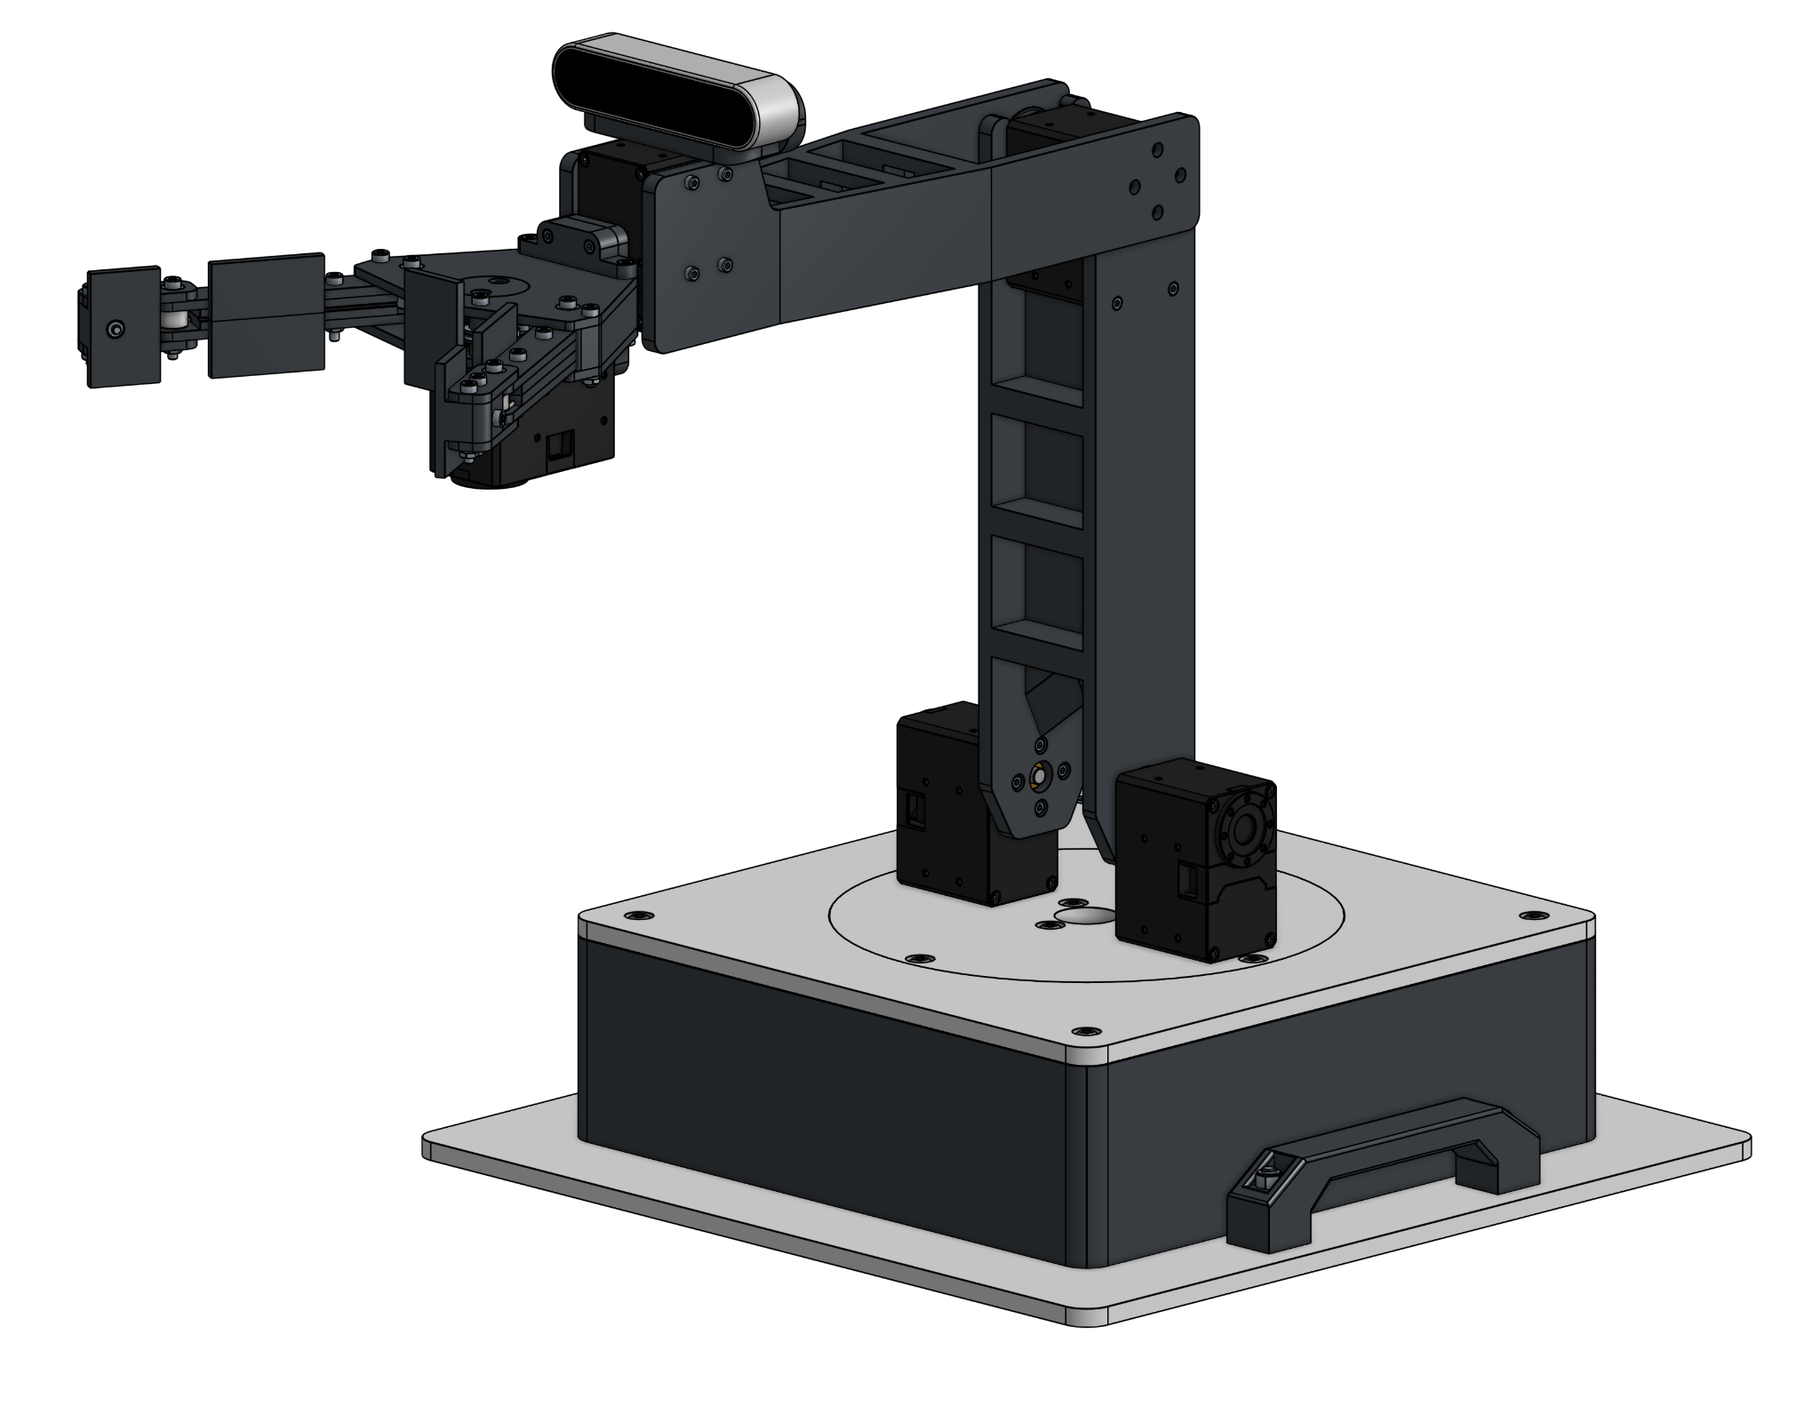
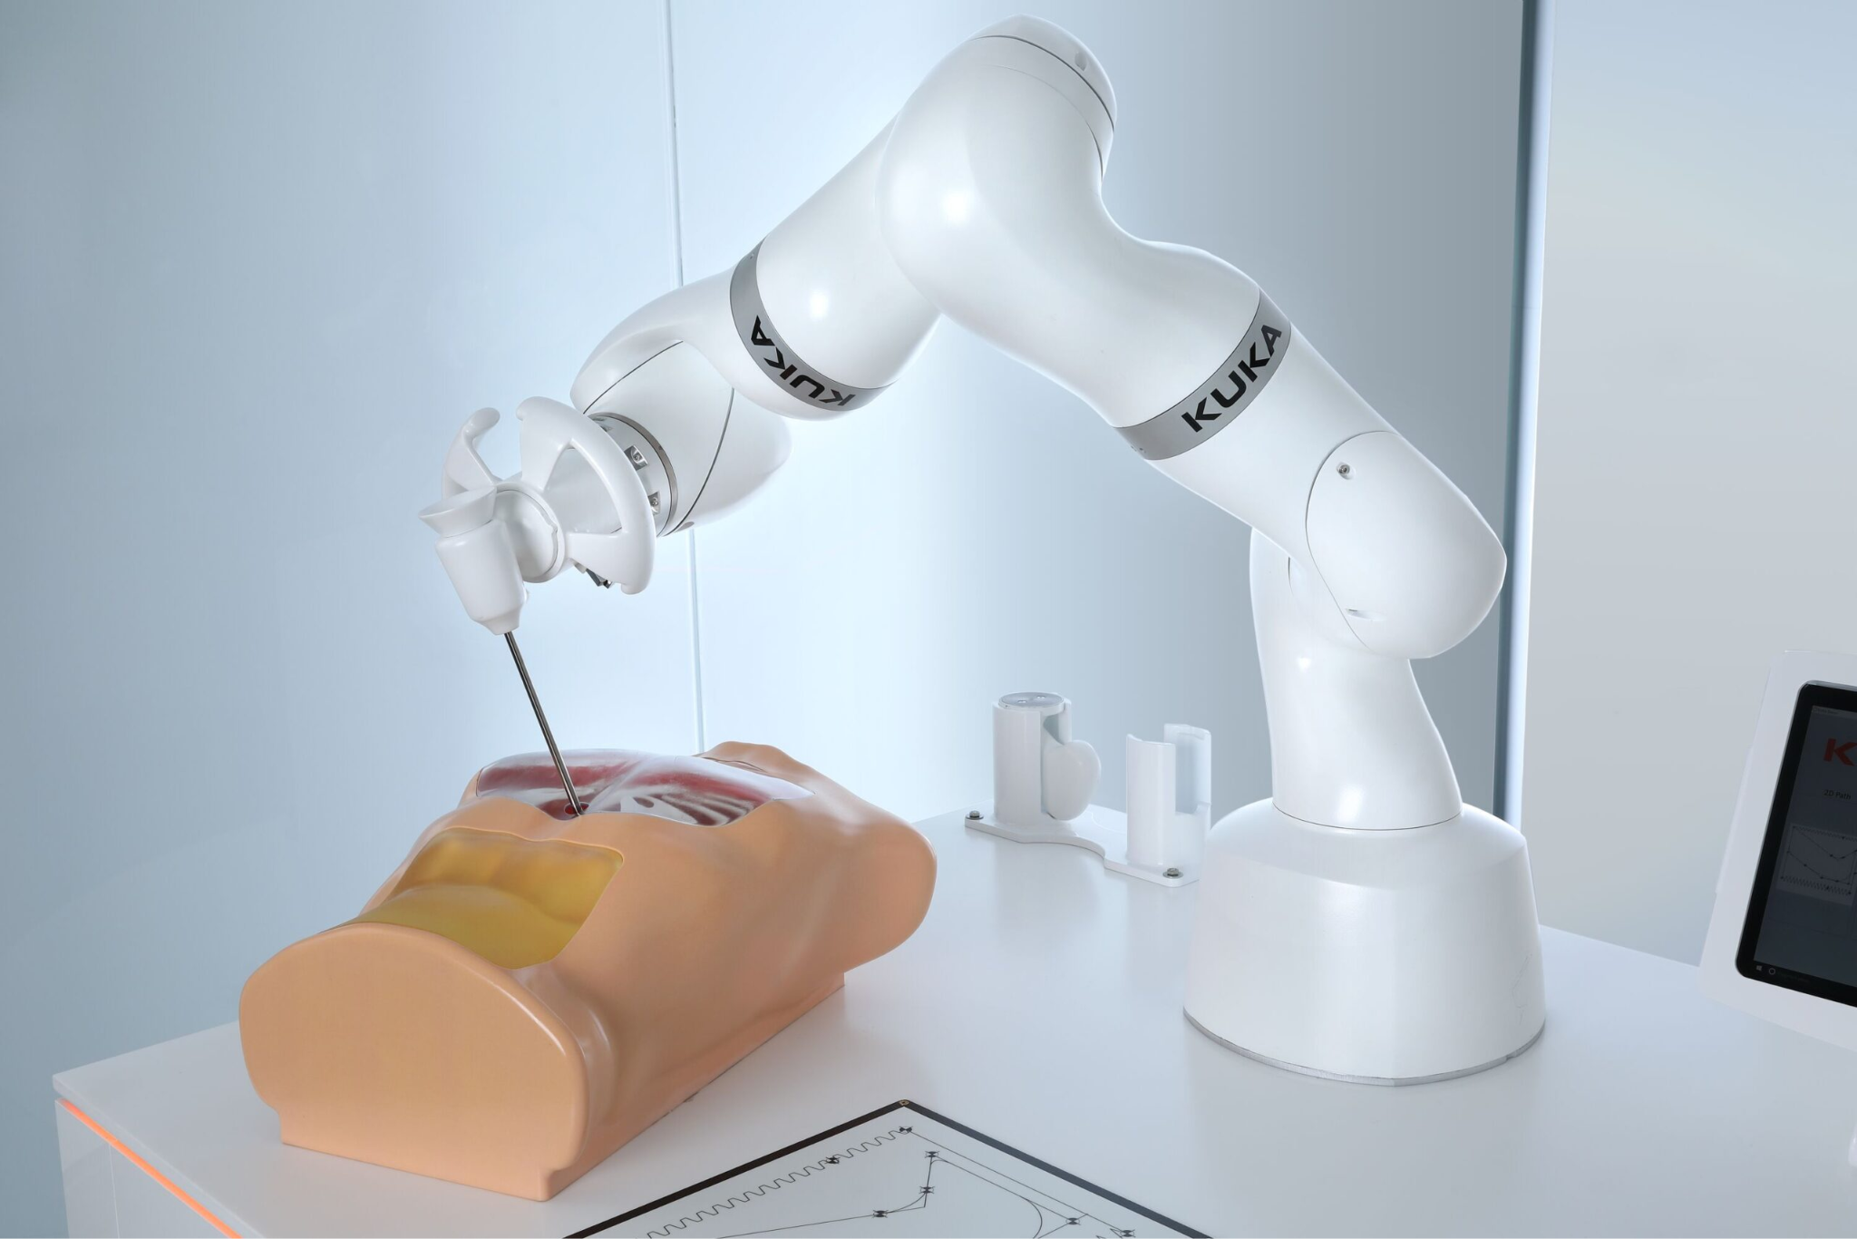
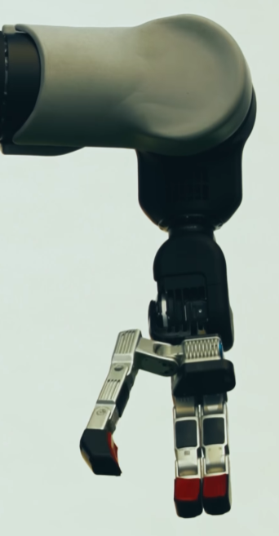
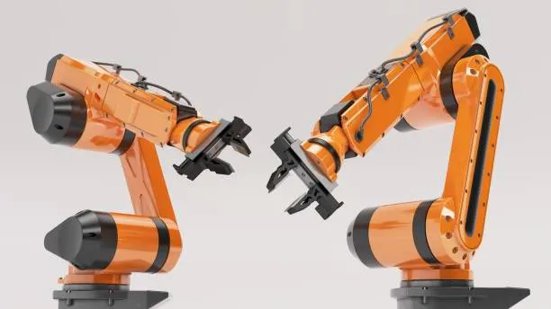
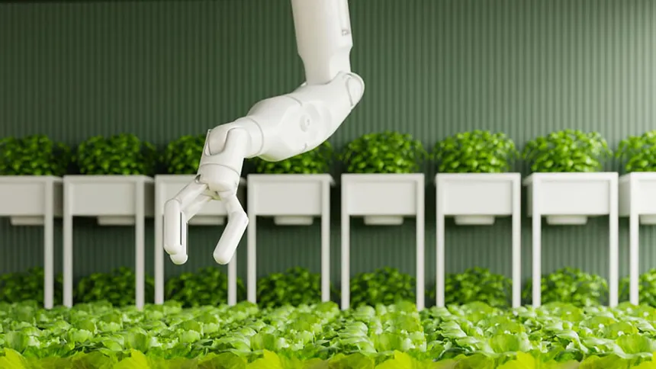
Introduction to the Robotic Arm
By Joseph Ruhan

Slide 2
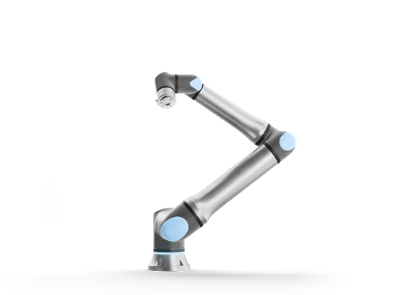
What Defines a Robotic Arm?
End Effector
Rigid Links
Joints
Image Credit: Universal Robots

Slide 3
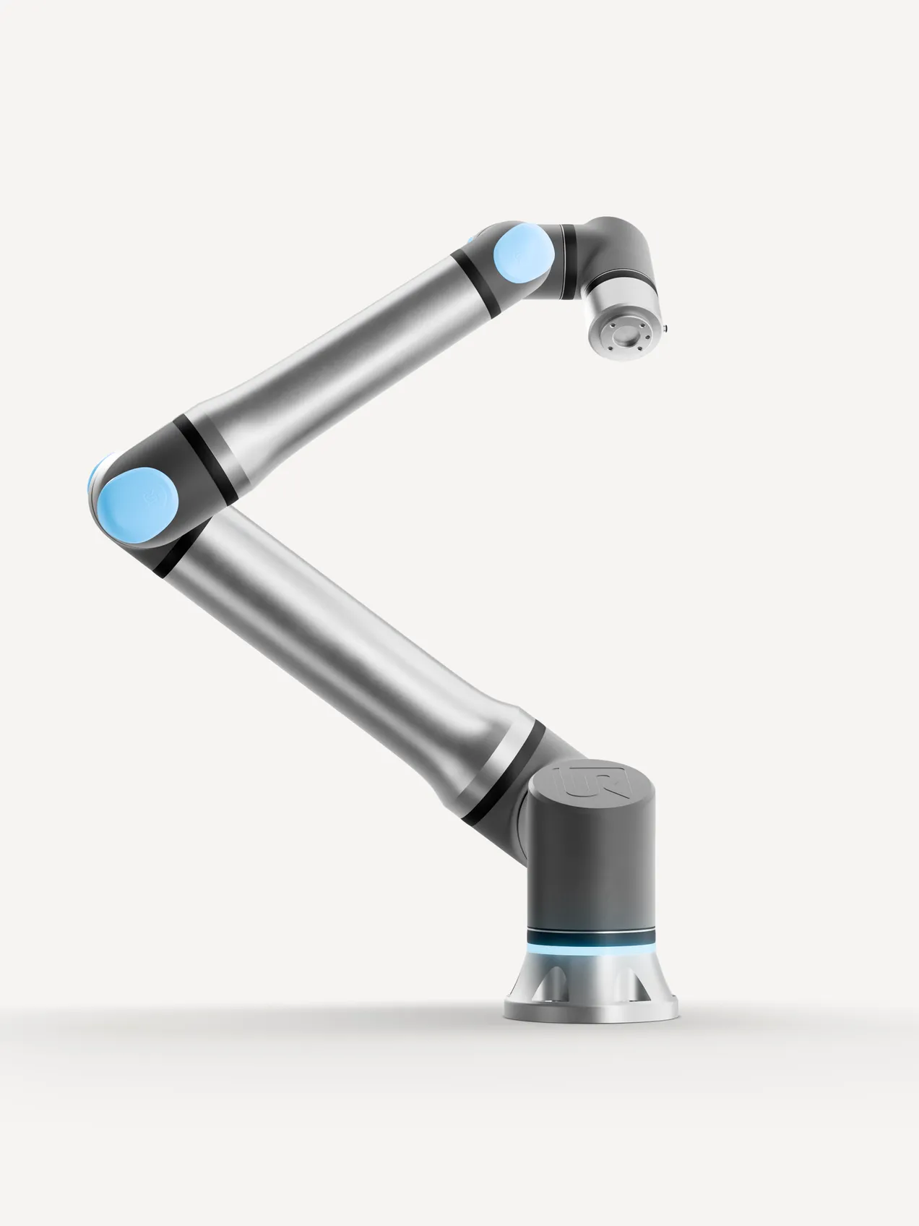

Joints
Joints are the rotating connections between segments of the arm. Joints are powered by actuators.
Joints
Image Credit: Universal Robots

Slide 4
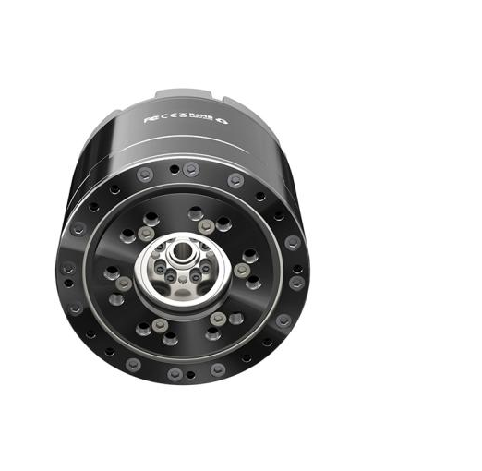
Actuators
Actuators are the components that drive rotation of joints.
They are most often composed of a motor and a gearbox.
Gearboxes are sets of gears that reduce speed in exchange for increasing torque.
Image Credit: CubeMars

Slide 5
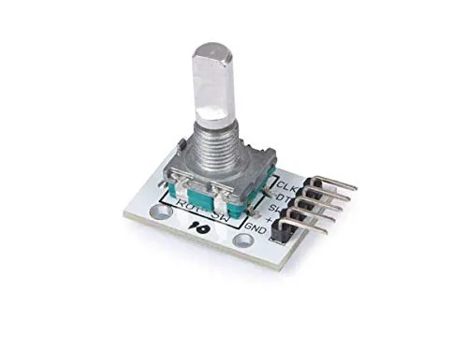
Encoders
Encoders measure the rotation of an actuator.
They measure rotation by measuring the strength of a magnetic field of a magnet attached to the actuator’s rotation.

Slide 6
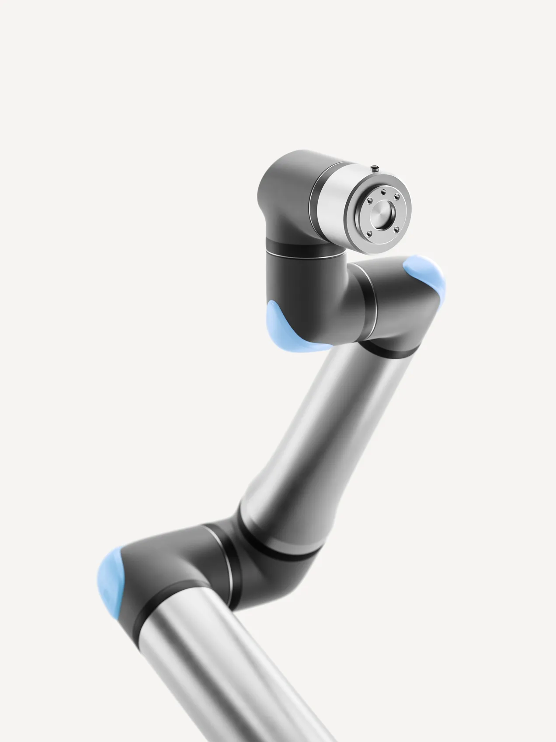
Rigid Links
Rigid Links are the solid connections between joints.
They can take many forms, such as solid tubes or flat plates.
Rigid Links
Image Credit: Universal Robots

Slide 7
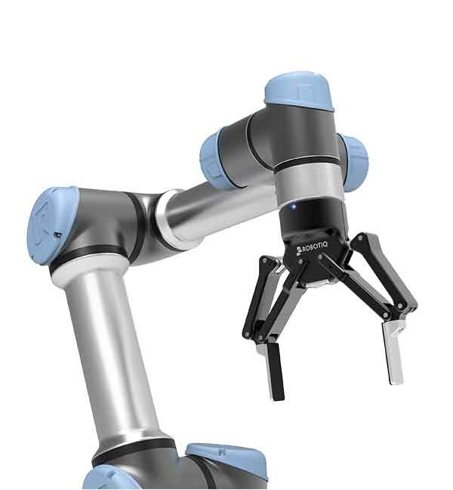
End Effectors
End effectors are the tool at the end of the robotic arm.
End effectors are the part that allows a robotic arm to achieve a specific task. They have multiple forms as hands, sensors, scissors, and many other tools.
End Effector
Image Credit: Universal Robots

Slide 8
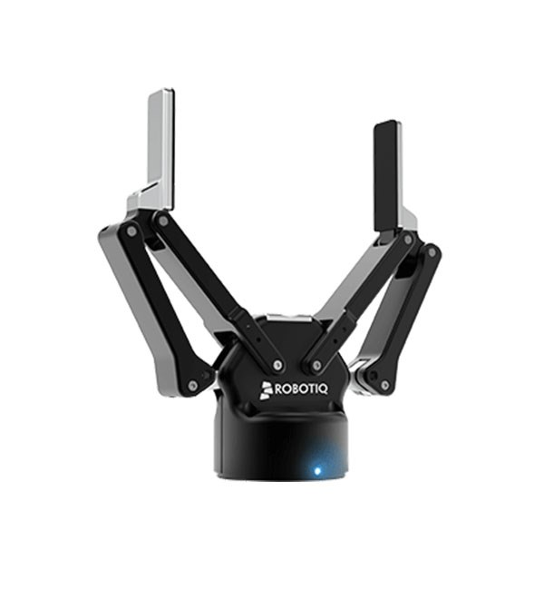
Gripper
One of the most common types of end effectors are grippers. They are used to hold or manipulate objects.
Gripper
Image Credit: Universal Robots

Slide 9
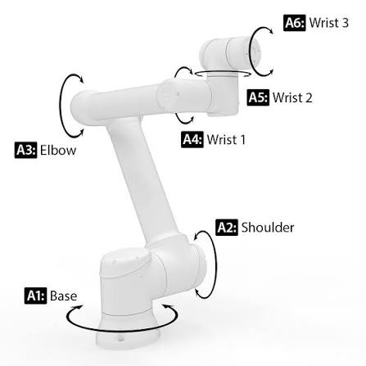
Degrees of Freedom
Degrees of Freedom (DOF) refer to the number of axes of rotation that determine the position of the end effector.
More degrees of freedom enables more positions for the robotic arm to use.
Robotic arms typically do not exceed 6 DOF because 6 DOF robotic arms are able to reach most useful positions.
Image Credit: Universal Robots

Slide 10
In This Course
4 DOF
Rigid Links
Gripper
Joints

Slide 11
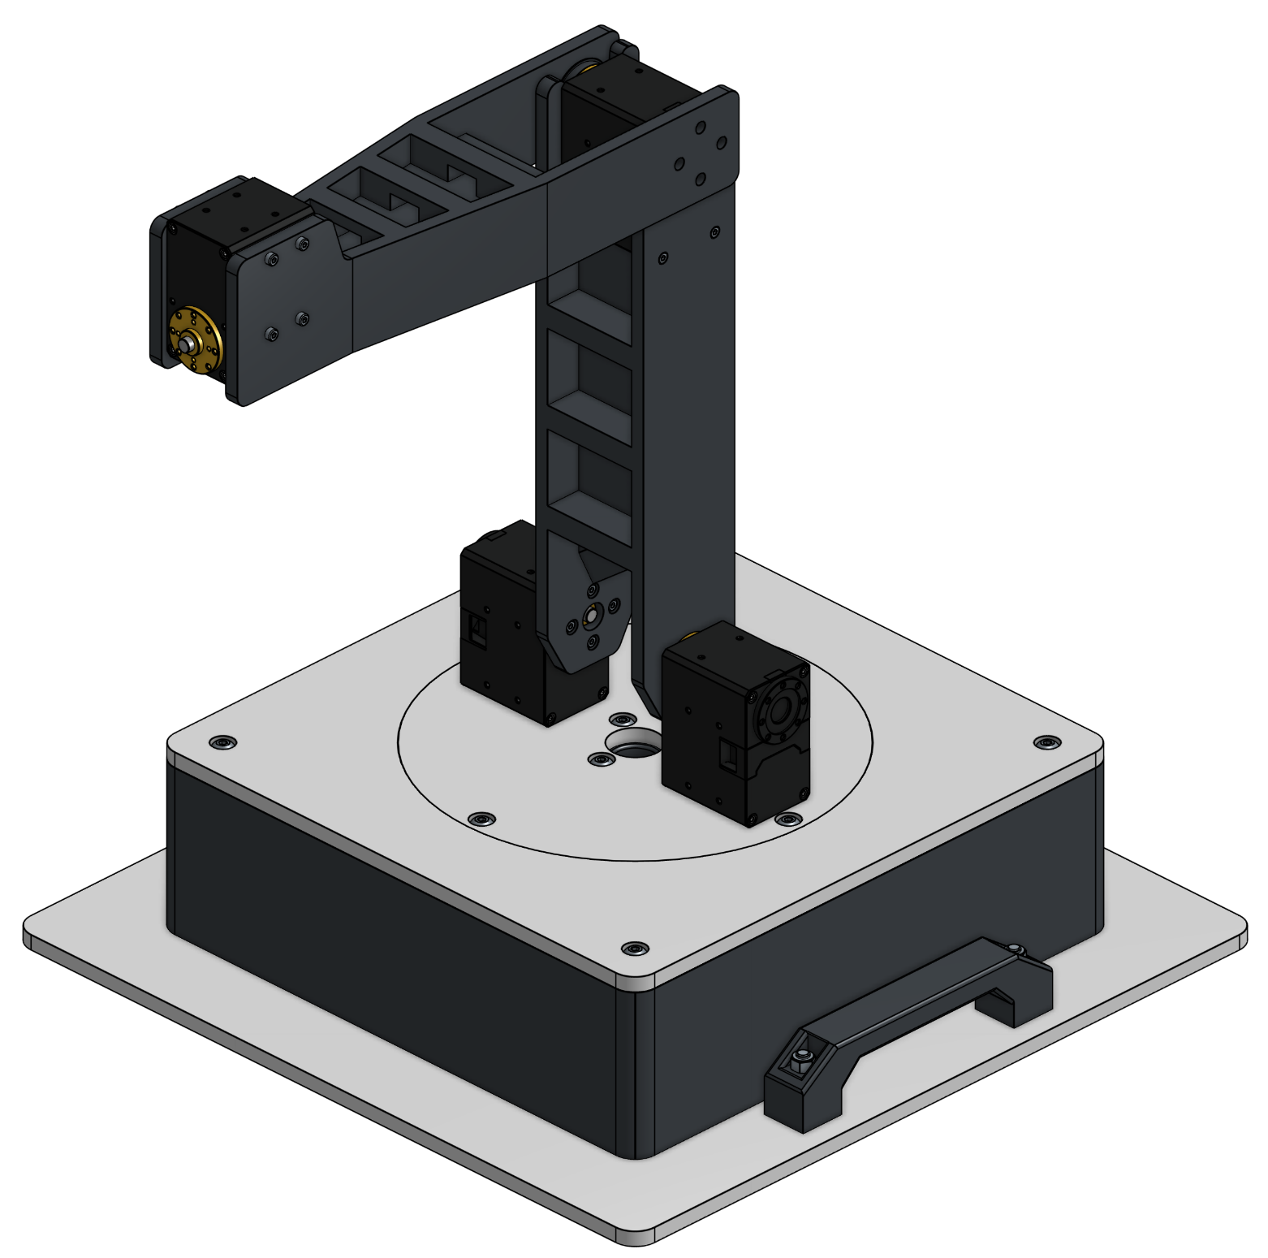
In This Course: Joints & Degrees of Freedom
Each joint in this arm corresponds to a DOF.
This course will use a 4 DOF robotic arm.
A 4 DOF robotic arm is able to provide valuable experience in control while not being as complex as a 6 DOF arm.
3.
4.
2.
1.
1. Base
2. Shoulder
3. Elbow
4. Wrist

Slide 12
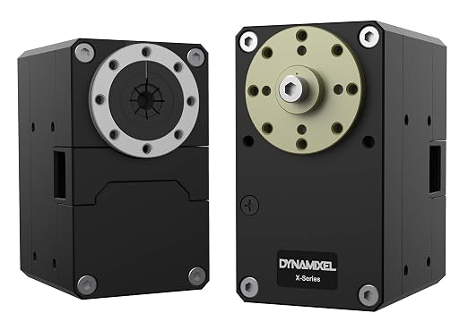
In This Course: Actuators
This arm uses Robotis Dynamixel XM54-W270-T actuators.
They contain a motor, gearbox, encoder, among other components necessary for actuator control.

Slide 13
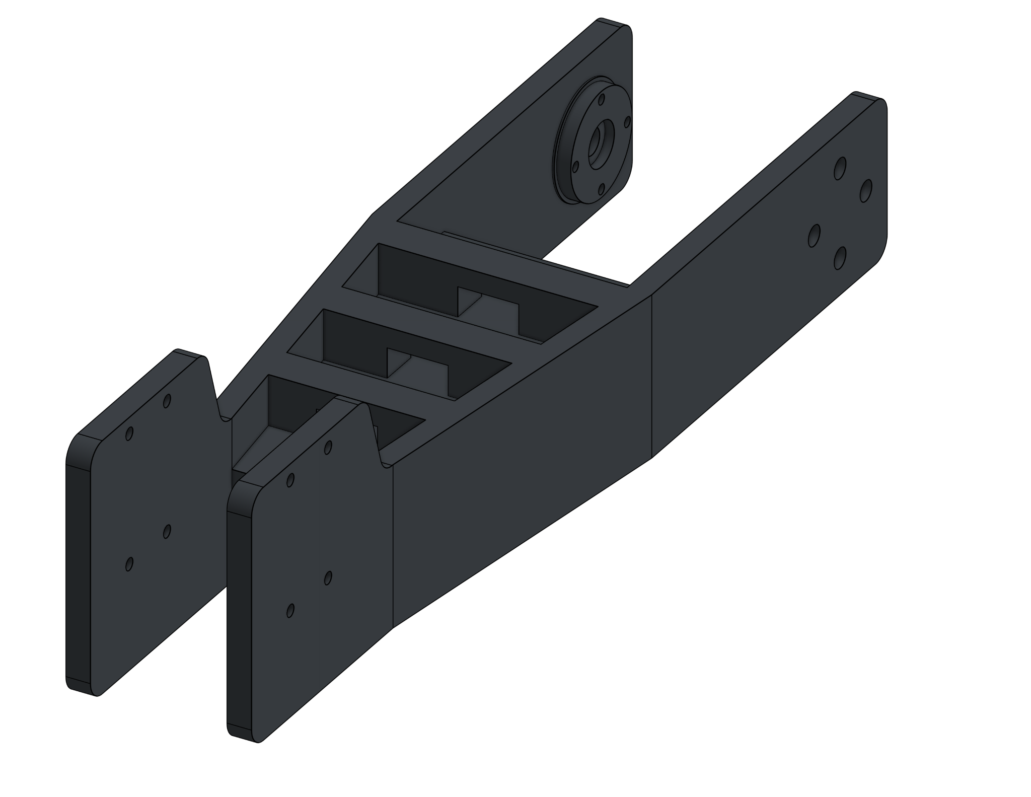
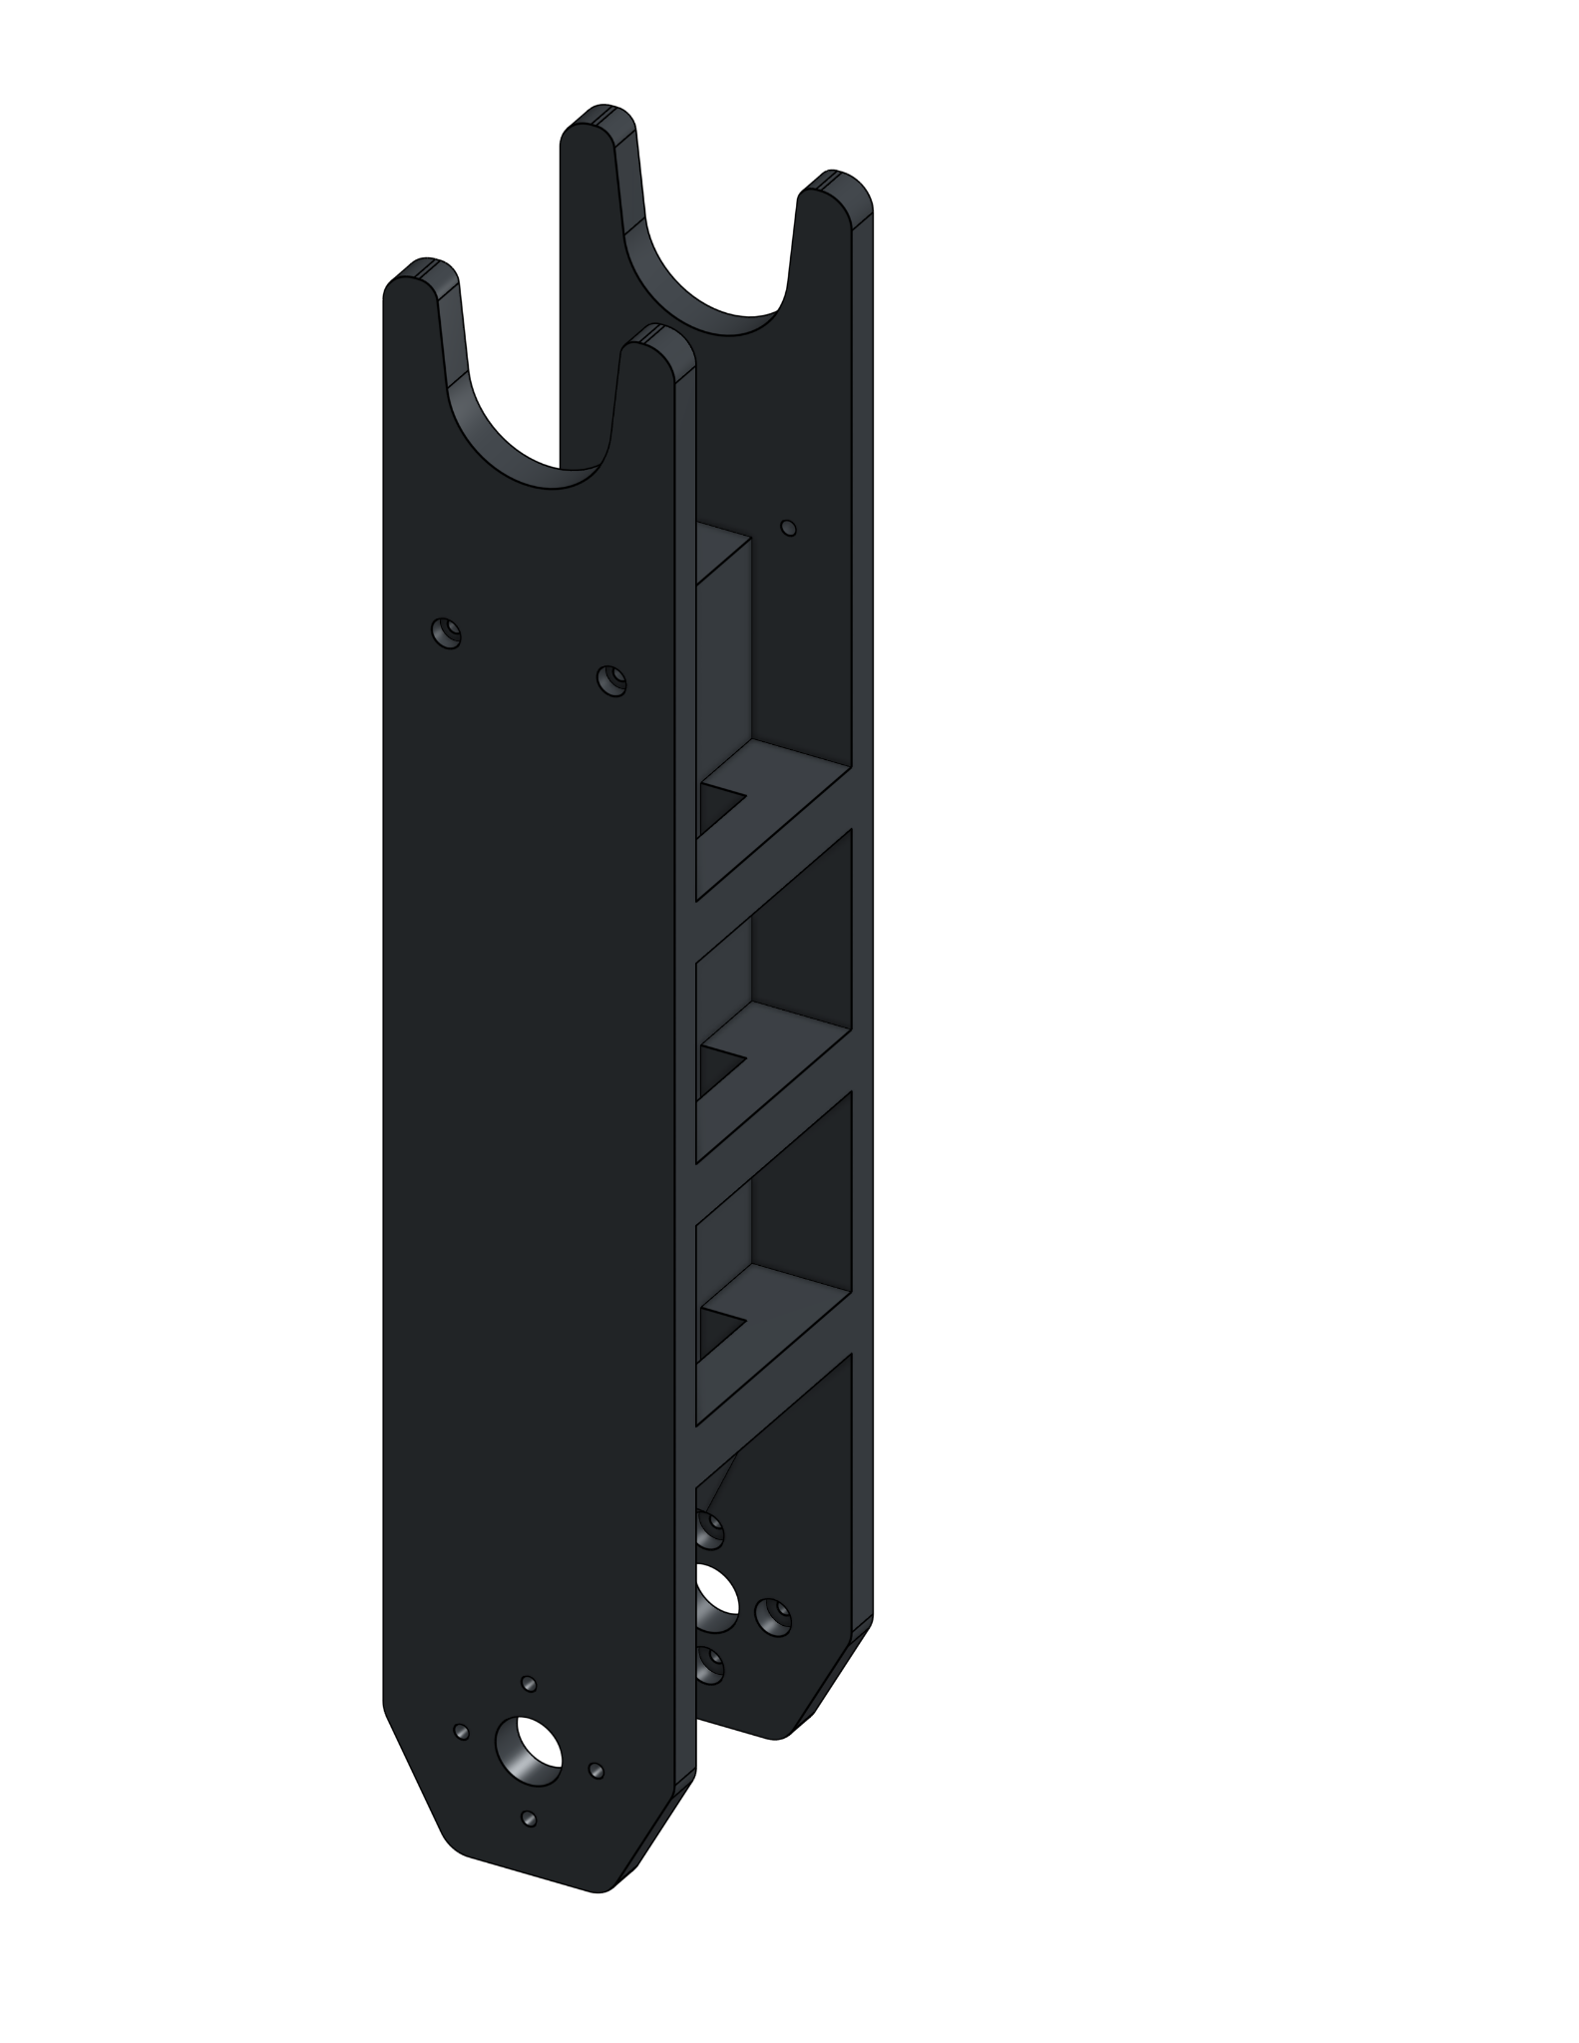
In This Course: Rigid Links
Lower Arm
This arm uses 3D printed segments to join the actuators together.
These are named corresponding to a portion of a human arm relative to the position of the shoulder (the bottom joint)
Upper Arm

Slide 14
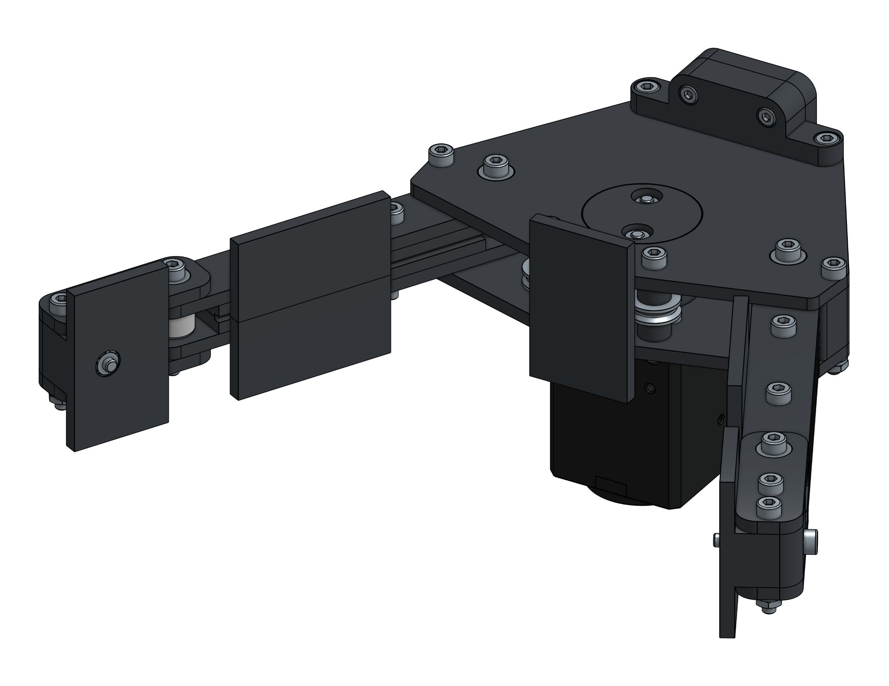
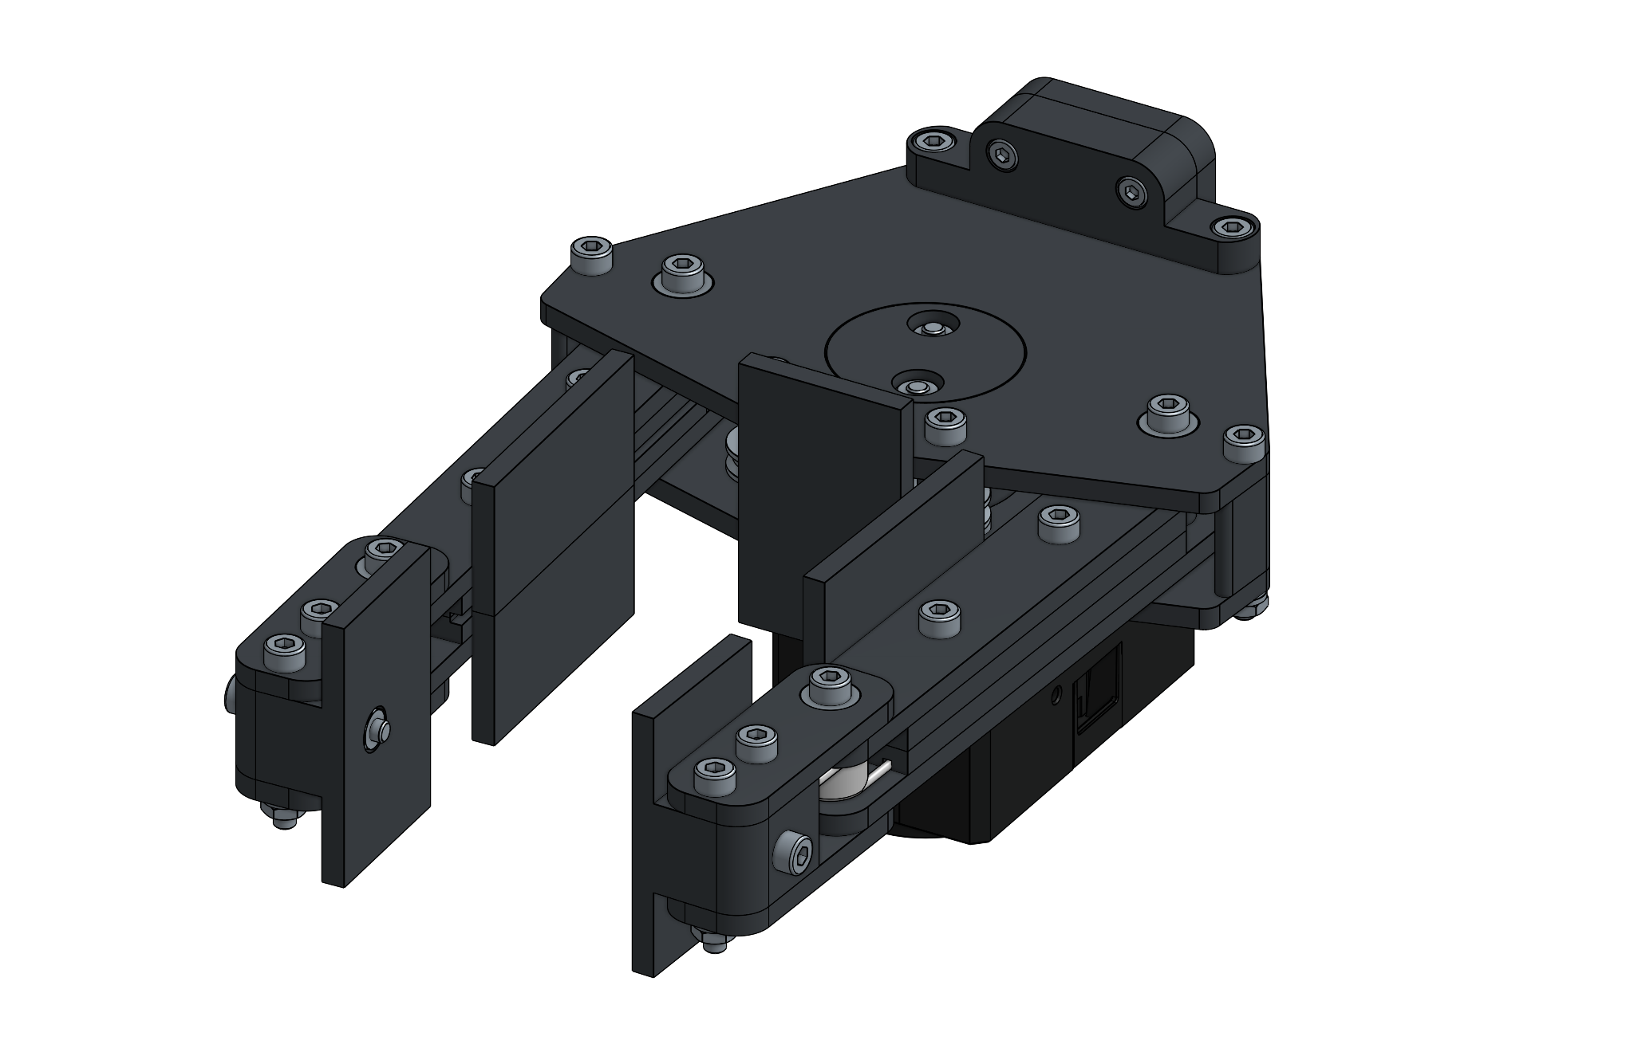
In This Course: End Effectors
This arm uses a gripper design.
This arm’s gripper uses two fingers to hold objects.

Slide 15
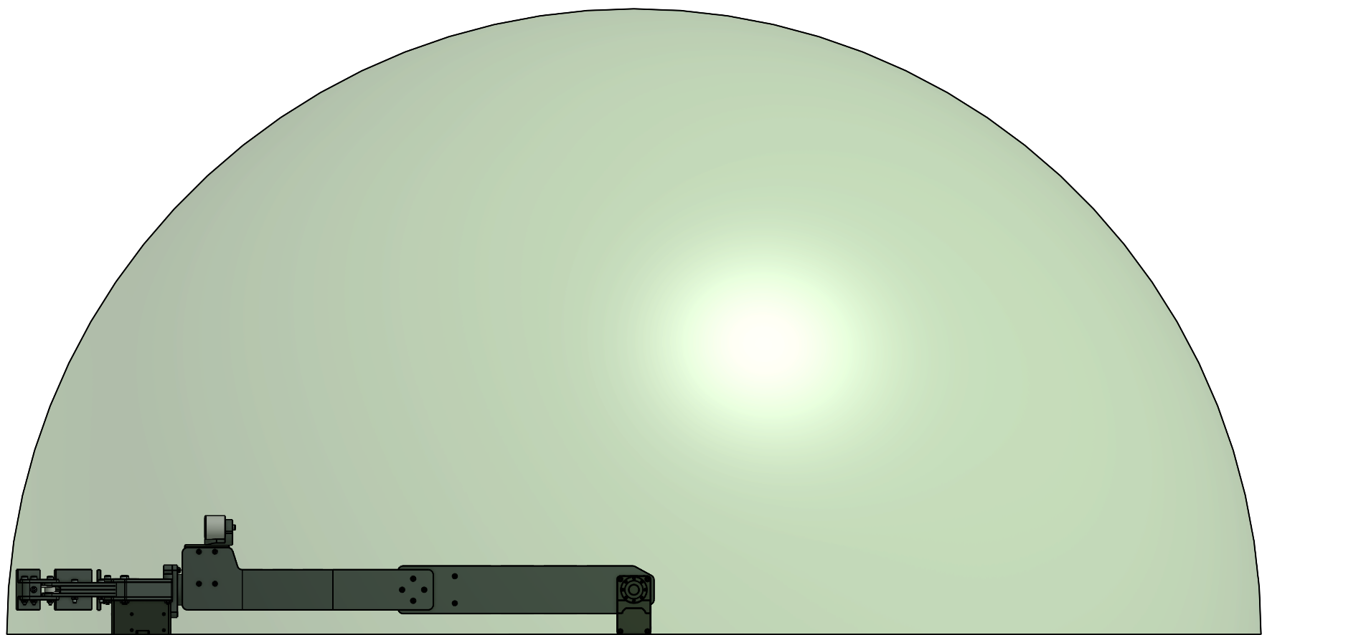
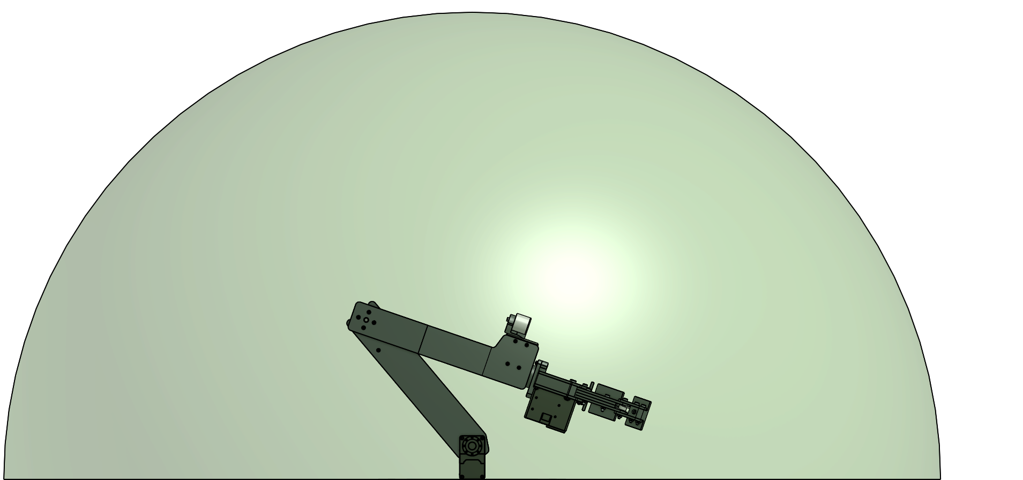
In This Course: Workspace
Workspace refers to the volume in which the arm can reach. It is best represented in this case by a hemisphere with the radius of the reach of the arm.

Slide 16
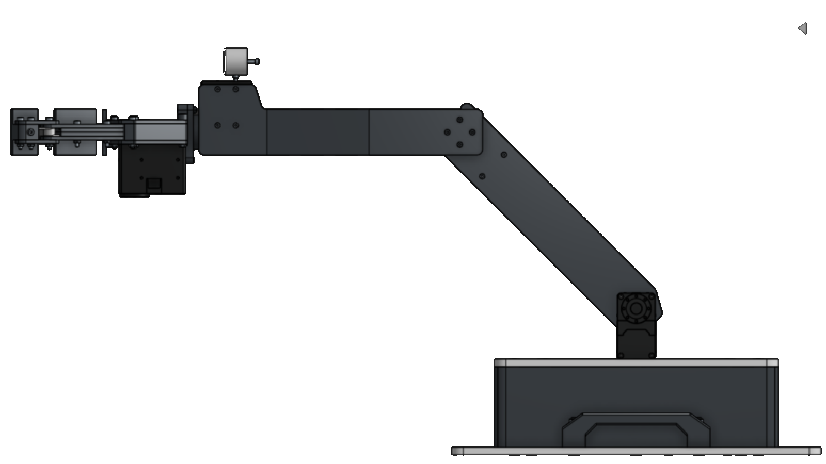
In This Course: Forward Kinematics
Workspace refers to the mathematical approaches to determine the position of the arm using known joint angles.
θ₂
θ₁

Slide 17
In This Course: Forward Kinematics
Workspace refers to the mathematical approaches to determine the joint angles of the arm given a desired end position.
(X,Y)

Slide 18
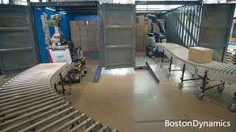
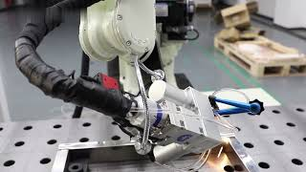
Why Robotic Arms? - Industry
Robotic arms provide versatility in movement.
This allows them to complete tasks other machines would not be able to accomplish.
Stretch (top video) uses the movement of a robotic arm to reach inside boxes and place them in any location
The welding robot uses the robotic arm to follow complex and varied paths to most effectively weld.

Slide 19
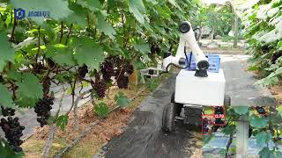
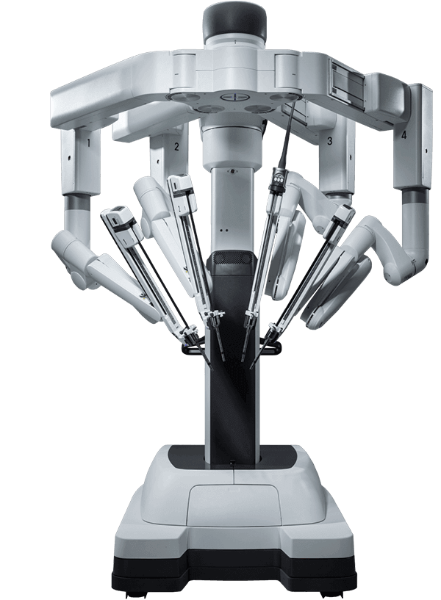
Why Robotic Arms? - Agriculture & Healthcare
The grape picking robot uses the versatility of a robotic arm to adapt to unpredictable locations of grapes. The robotic arm allows the robot to pick grapes at many positions.
The da Vinci Surgical System (bottom image) utilizes four robotic arms to enhance a doctor’s precision. The use of robotic arms enables the system to be versatile and perform complex tasks.

Slide 20
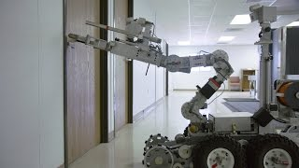

Why Robotic Arms? - Service
Bomb defusal robots use robotic arms to interact with dangerous payloads. Robotic arms allow one robot to access many locations and interact with many items.
Humanoid robots use robotic arms as we do. Robotic arms are the most general solution to interaction with the world. Robotic arms allow for the widest variety of movement and greatest versatility.

Slide 21
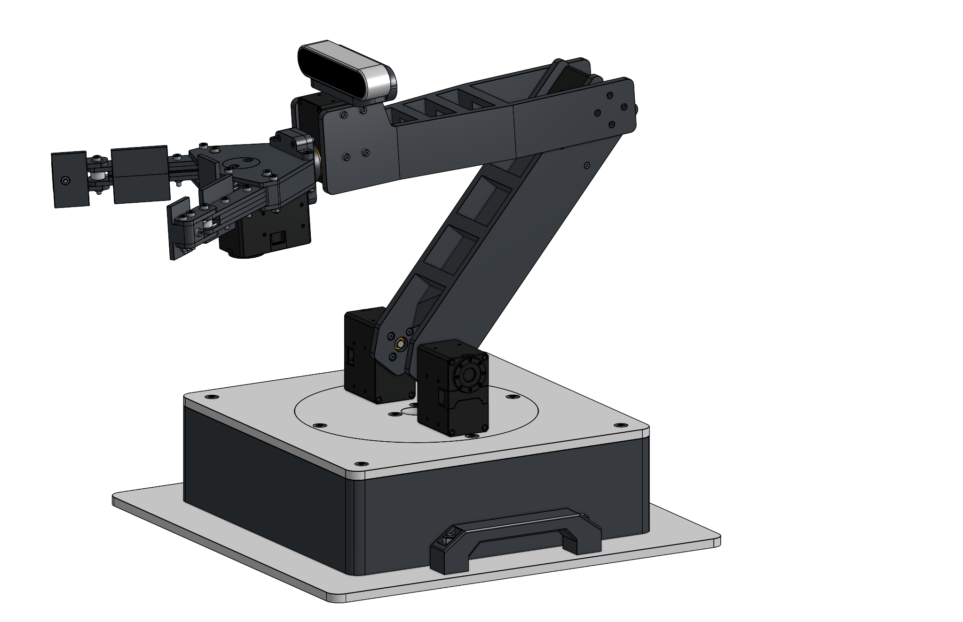
Robotic Arm Safety
Do not put your fingers in between the upper and lower arm segments. You can get pinched by the sharp walls.

Slide 22
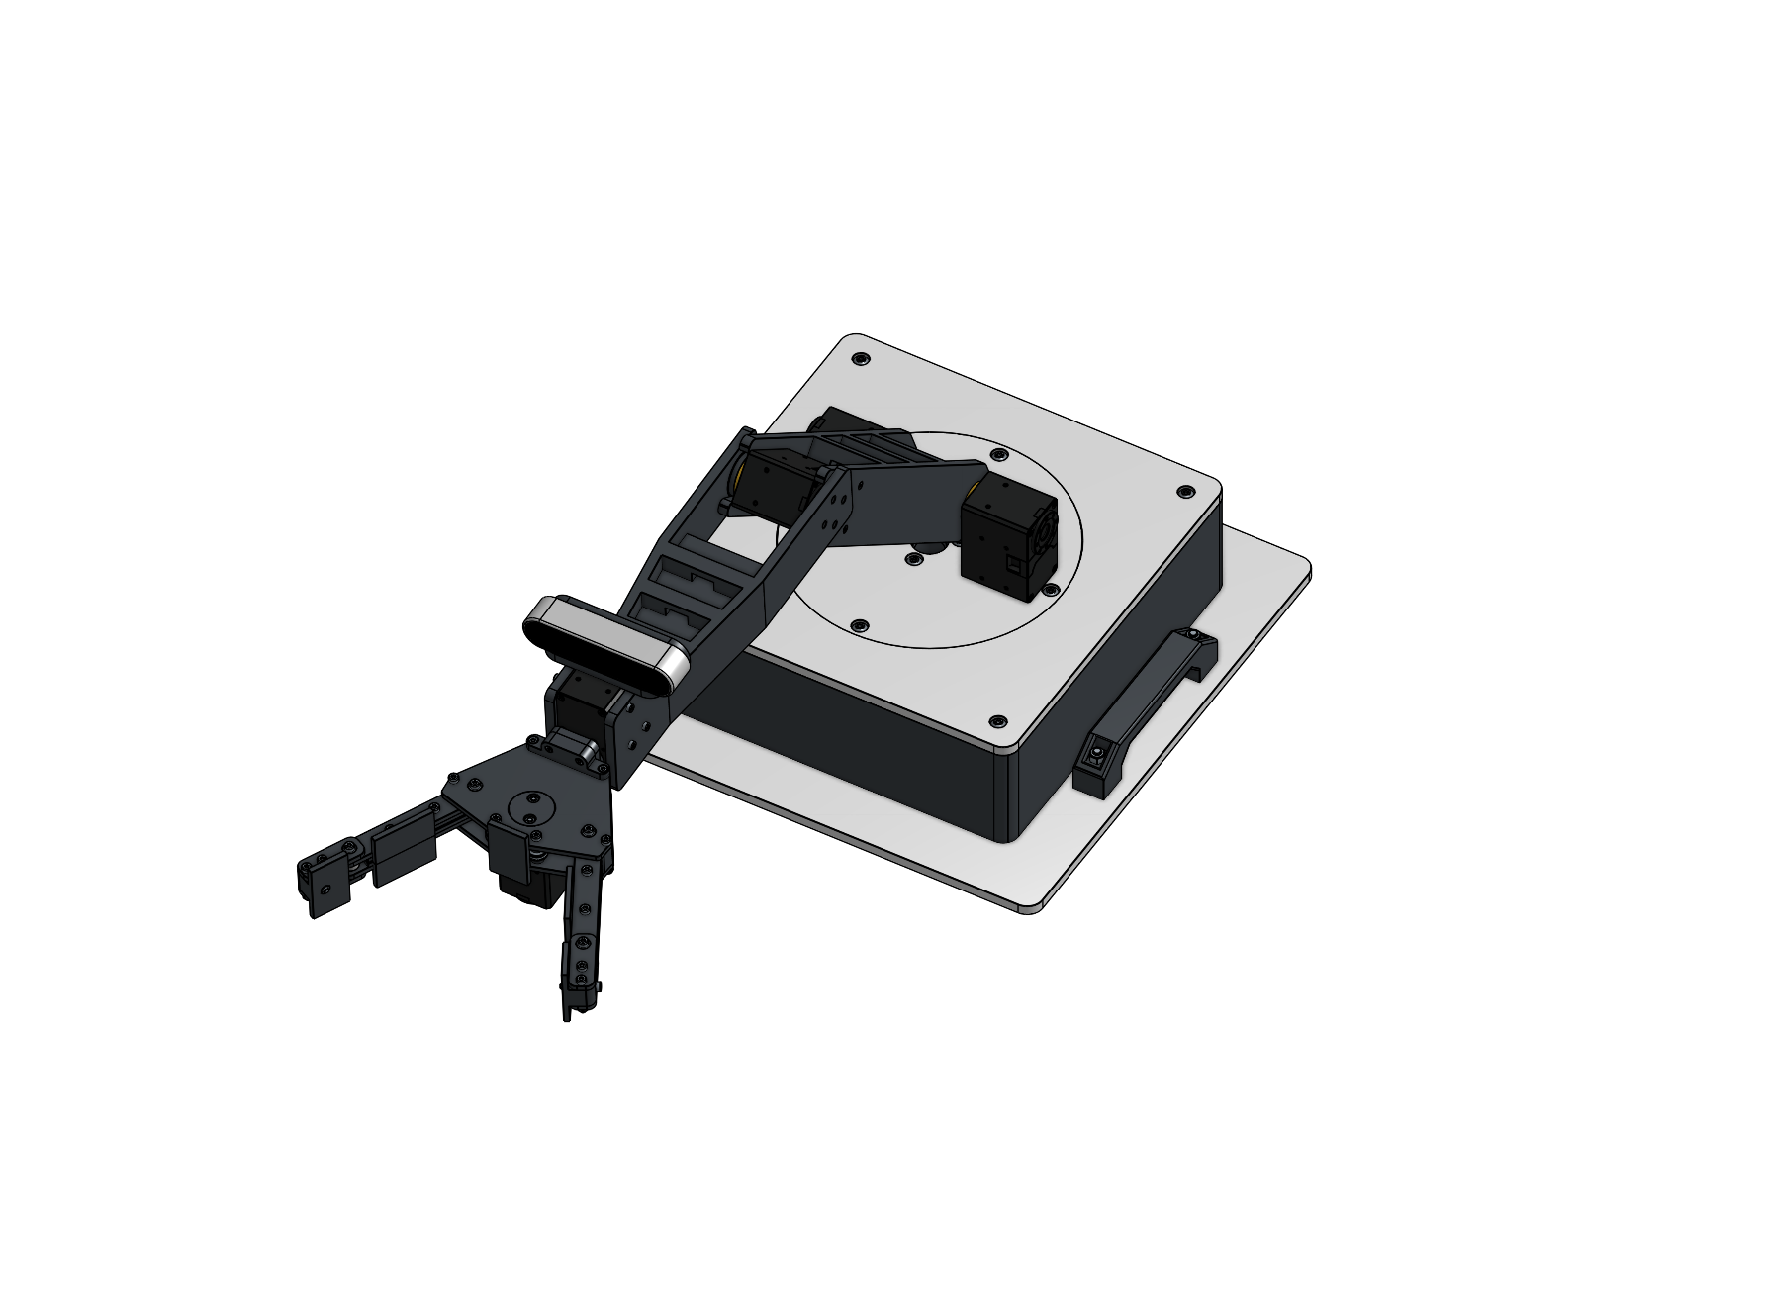
Robotic Arm Safety
While the arm is powered on, do not get too close to it.
If the arm acts in an unexpected way, turn the power off immediately.

